Slide 1


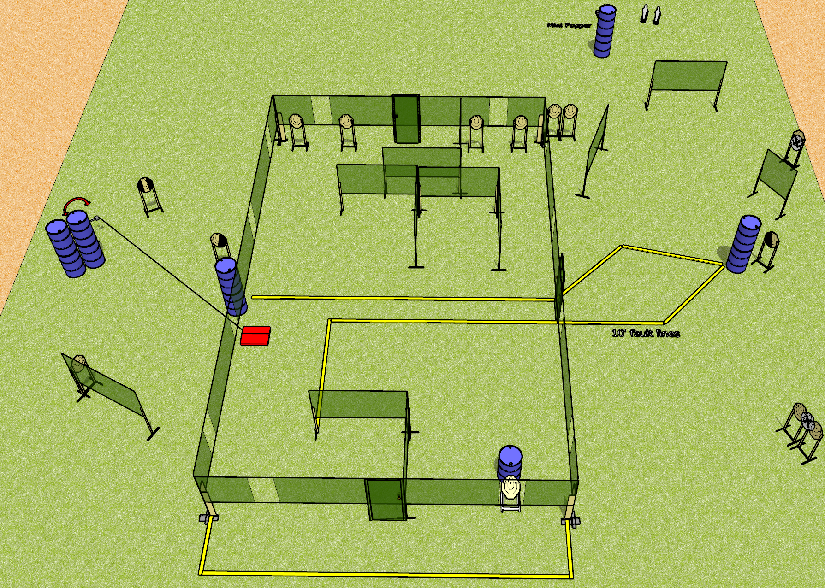
 | Dothan Gun Club – USPSA Match Shoothouse Shuffle Course Designer : Drew Coleman
Round Count 33 rounds 15 IPSC 3 mini poppers
Equipment List 8 wall feet 3 medium fault lines Swinger + stomp box 1 left + 1 right diag, 1 tux

Slide 2
Shoothouse Shuffle
Written Stage Briefing
Shoothouse Shuffle is a 33 round, 165 point, Comstock course of fire. There are 15 IPSC targets and 3 mini poppers. The best 2 hits on paper will score and steel must fall to score. The start signal is audible.
The swinger is activated by the stomp box and remains visible at rest. The stomp box is part of the shooting area
All doors must be shut at the start signal.
Handgun start position is fingers of both hands touching front door handle. Handgun is loaded and holstered.
PCC start position is muzzle touching front door handle, stock on belt. Loaded carbine is held with both hands, safety on.
On start signal, engage targets as they become available from within the shooting area.

